Slide 1

On the microeconomics of technological change and agricultural development
Chris Barrett, Cornell University
Guest Lecture to Earth Systems 185: Feeding Nine Billion
Stanford University
March 10, 2020

Slide 2
A few key questions
A few key ideas from “development microeconomics”: the study of constrained choices by individuals, firms and groups in developing economies.
Why does ag tech change matter to development?
How do new technologies arise and diffuse?
Who gains from technological advances? Why?
4) What implications for IP? R&D financing?
5) What might impede diffusion of new tech?
6) How are markets/contracts like technologies?

Slide 3
Why ag tech change?
Growing demand (income, population growth, stature)
Finite planetary resources and increasing value to alternate land/water/labor uses
Implication: Must increase output/input to satisfy growing human demand and respect natural scarcity
Also: Various estimates consistently suggest that real economic growth from agriculture is ~3x more effective than non-ag growth in reducing headcount extreme poverty.

Slide 4
Why ag tech change?
Ag technological change especially important
“Most of the people in the world are poor, so if we knew the economics of being poor we would know much of the economics that really matters. Most of the world’s poor people earn their living from agriculture, so if we knew the economics of agriculture we would know much of the economics of being poor.”
- Theodore W. Schultz
Opening sentences of 1979 Nobel Prize in Economics lecture

Slide 5
Why ag tech change?
What spurs agricultural growth?
Three possible sources of agricultural growth:
Increased use of inputs (land, water, labor, capital) brings more output, but typically at diminishing rate. Implies reduced marginal returns to labor (i.e., lower real wages and higher poverty) and environmental degradation (X⁰ to X¹).
Increased efficiency in using existing inputs and technologies, commonly through extension (Y⁰ to Y¹). But Schultz’s (1964) “poor but efficient” hypothesis suggests limits to this option.
Technological change to increase output potential given same inputs. Requires innovation, diffusion and farmer adaptation to change. This is the main long-term source of productivity growth for sustainable poverty reduction.
Output
New Production Possibility
Production Possibility
Y¹
Y⁰
Input
X⁰
X¹

Slide 6
How tech change?
Sources of technological change
Induced innovation model: private agents innovate so as to conserve relatively scarce/dear inputs (‘factors’) and to increase relatively valuable outputs. So ‘factor bias’ in technological change varies by region (Hayami & Ruttan).
Strategically targeted investments by not-for-profit donors and governments: CGIAR, GAVI, etc.
Serendipity
Empirical evidence: induced innovation most important. But because II turns on price signals, market distortions due to policies, geography, etc. imply that pro-poor innovations often undervalued, hence the need for processes 2 and 3.

Slide 7
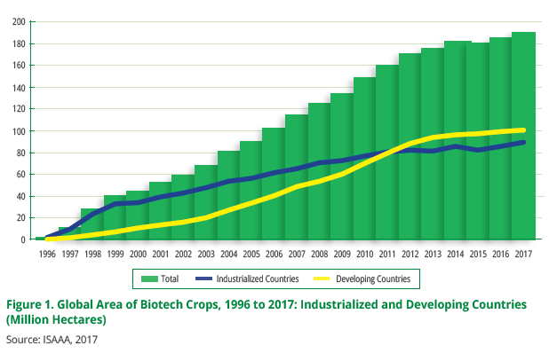
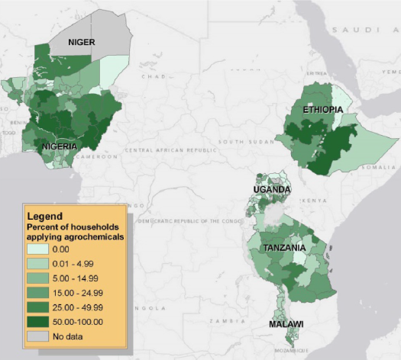
How tech change?
Tech diffusion
Rapid diffusion of GM crops worldwide … fastest ag innovation diffusion in history!
Sheahan and Barrett, Food Policy 2017

Slide 8
How tech change?
Tech diffusion
In Vietnam, farm machinery diffused rapidly 1992-2016. Clear economies of scale, manifest in a pronounced positive - machinery ownership relationship. Rental markets virtually erased the farm size gradient in machinery use, leading to rapid mechanization in response to rising real wages and non-farm diversification of farm hhs.
Liu et al. IFPRI working paper 2019

Slide 9
Who wins?
“Technology treadmill” and gains from change
Irony: big winners from most ag tech change are typically consumers not producers. Why?
Naïve model
Demand is perfectly elastic. Gains accrue to producers.
But when, if ever, does this really happen?
Small-scale change: early adopters (who?)
Perfect market integration … export surplus production
New Supply
Price
Original Supply
Demand
P
Producer
Surplus
Added Producer
Surplus
Quantity

Slide 10
Who wins?
“Technology treadmill” and gains from change
Irony: big winners from most ag tech change are typically consumers not producers. Why?
Price
More realistic model
Price inelastic demand.
Fallacy of composition: what’s true at small scale (tech. change profitable for first few adopters) not true at large scale.
Hence tech treadmill
Demand
New Supply
Original Supply
Consumer
Surplus
P ^{old}
Old Producer
Surplus
New Consumer
Surplus
P ^{new}
New Producer
Surplus
Quantity

Slide 11
Who wins?
So how does ag tech change matter?
Increase farm profits, at least for early adopters: Those with best access to ICT, extension, credit/insurance, input and output markets, etc. These farmers gain from yield increases, cost reductions, or both.
Boost rural labor demand: Rural poor typically work off-farm (at least part-time). Enjoy labor market gains, both through more hours worked and higher real wages.
Reduce food prices: If enough adoption, aggregate supply shifts and prices fall (by how much depends on integration with national and global markets). Poor usually net food consumers who gain.
Result: Broad-based but uneven and evolving gains

Slide 12
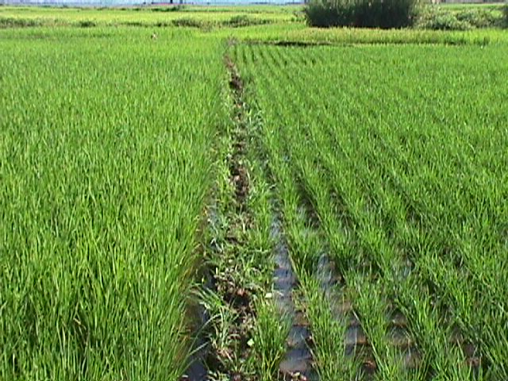
Who wins?
Adding it all up … an example from Madagascar:
A doubling of rice yields:
reduces the share of food insecure
households by 38%
shortens the average hungry period
by 1.7 months (1/3)
increases real unskilled wages in
lean season by 89 % (due to both
price and labor demand effects)
All the poor benefit: unskilled
workers, consumers, and net seller producers
… the poorest gain most.
(Source: Minten and Barrett, World Development, 2008).

Slide 13
Implications for IP/$
“Technology treadmill” and gains from change
Some key policy implications
Price
Intellectual Property
What differences emerge from open source/public licensing vs. private IP?
Financing
Who should pay for R&D? How does it depend on IP?
Demand
New Supply
Original Supply
Consumer
Surplus
P ^{old}
Old Producer
Surplus
New Consumer
Surplus
P ^{new}
New Producer
Surplus
Quantity

Slide 14
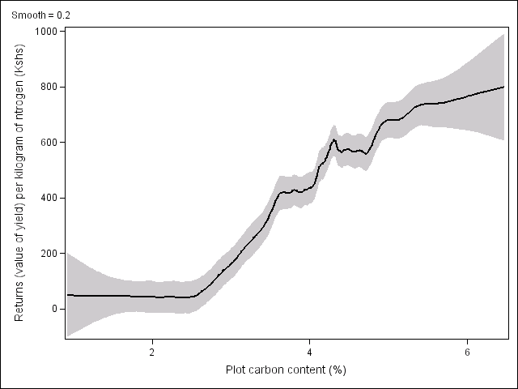
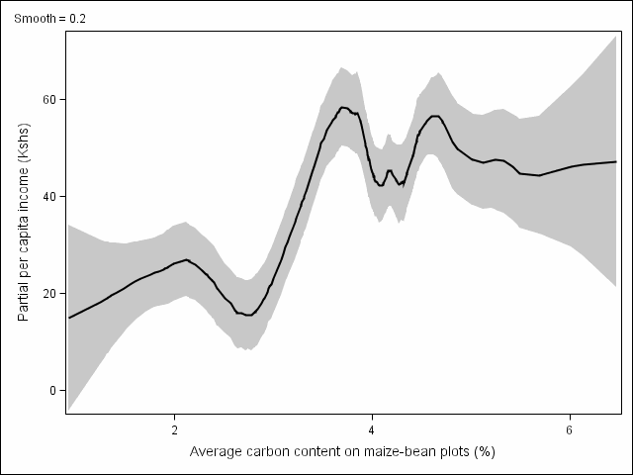
What impedes diffusion?
Non-uptake of seemingly promising technologies:
SRI in Madagascar and seasonal credit/labor requirements (Moser & Barrett Agr Econ 2006)
Improved NRM in w. Kenya, complementarities w/land livestock/cash endowments (Marenya & Barrett FP 2007)
Inorganic fertilizer in w. Kenya (Marenya & Barrett 2009).
Above red line: fertilizer profitable
Value of maize from 1 kg of nitrogen
Cost of 1kg nitrogen
Below red line: fertilizer unprofitable
(Source: Marenya and Barrett, AJAE 2009).

Slide 15
Markets as technologies
Markets as like technologies
From a household’s perspective, market exchange is like a production technology:
one way to ‘produce’ good 1 is to produce some
other good 2 and then exchange it for good 1.
Market participation is therefore like technology adoption and can be studied similarly:
  … in both cases, fixed costs and risk matter a lot
  … too easy to fall into in a low-level eqln trap
So just as technological change in agriculture is central to poverty reduction, so is the growth of agricultural marketing channels. They go together.

Slide 16
Example: Rice market participation by land holdings, Madagascar 1990
Markets as technologies
Market ‘failures’ may be hh-specific (“idiosyncratic”). Risk, transactions costs, etc. drive a wedge between observed market prices and the “shadow price” faced by a hh.
“Subsistence” farming occurs when growers self-select out of mkts. Autarky requires adeq. endowments.
Source: Barrett and Dorosh (AJAE 1996)

Slide 17
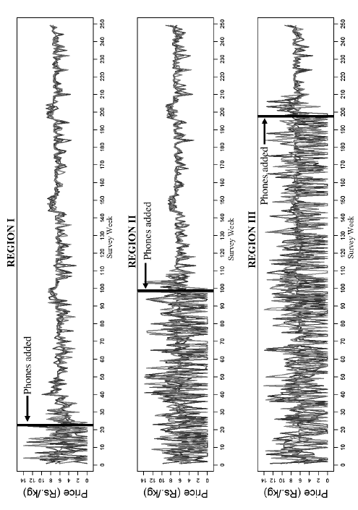
Markets as technologies
Example: Kerala fishermen and cell phones
Source: Jensen QJE 2007

Slide 18
Markets as technologies
Sell low/buy high marketing behaviors: maize in Kenya (Stephens and Barrett J. Agr. Econ. 2011)
Faced with sharp seasonality in prices, farmers often sell at post-harvest lows even when they know they will buy back at lean season highs, simply because they lack credit access and need cash.
A different mkt (credit?) may be key: “displaced distortions”

Slide 19
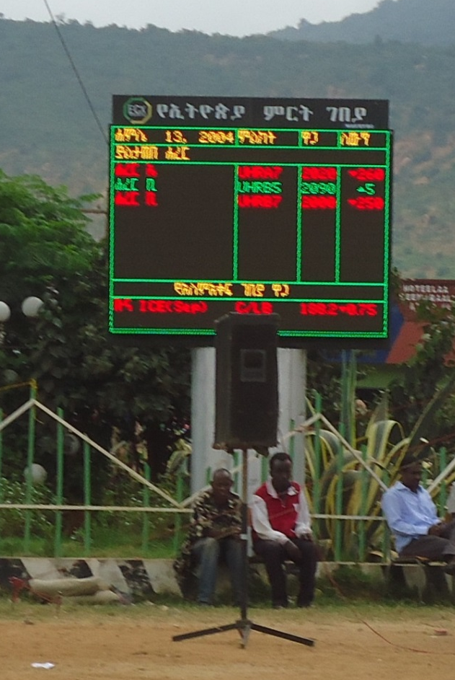
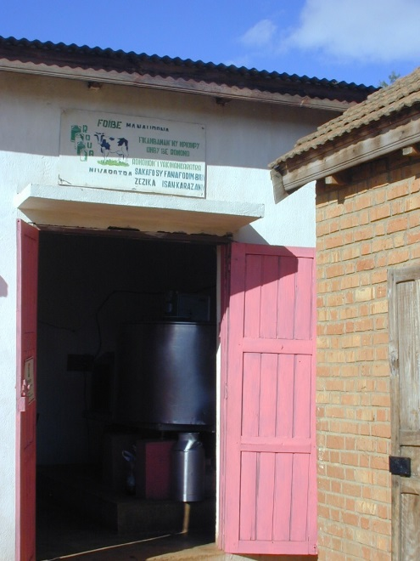
Questions?

